Slide 1
Principles of management
Session 6

Slide 2
Management is essential to any organization that wishes to be efficient and achieve its aims. Without someone in a position of authority there would be organizational anarchy(a state of disorder) with no structure and very little focus.

Slide 3
It has been said that management has five basic functions – planning, organizing, staffing, leading and controlling.
Without these principles of management being in place an organization would have trouble achieving its aims, or even coming up with aims in the first place!
A classic theory on the principles of management was written by Henri Fayol.

Slide 4
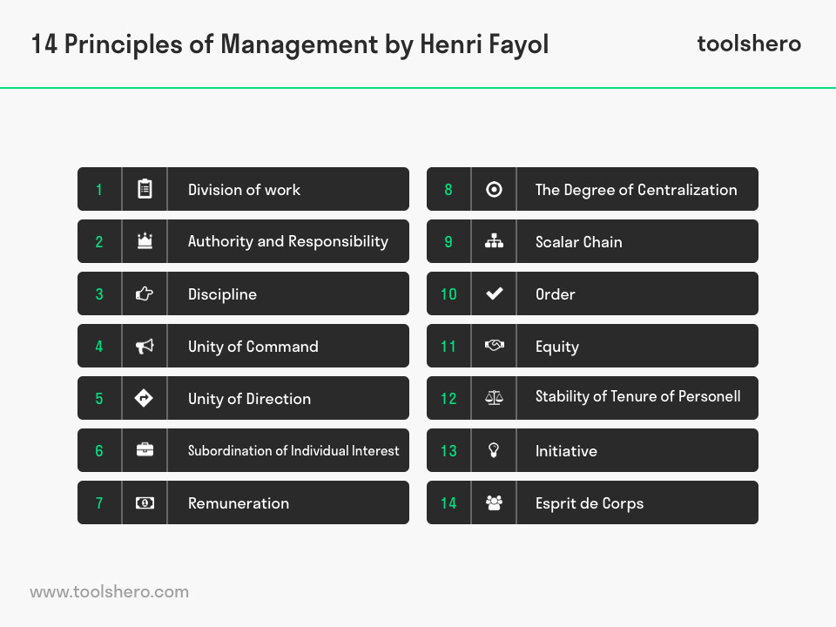

Slide 5
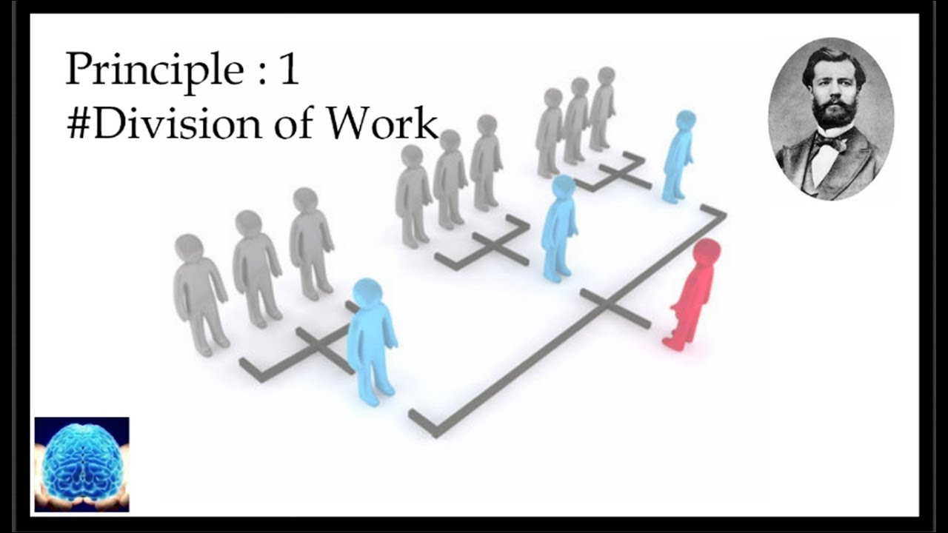
Division of Work
In practice, employees are specialized in different areas and they have different skills. Different levels of expertise can be distinguished within the knowledge areas (from generalist to specialist). Personal and professional developments support this. According to Henri Fayol specialization promotes efficiency of the workforce and increases productivity. In addition, the specialization of the workforce increases their accuracy and speed. This management principle of the 14 principles of management is applicable to both technical and managerial activities.

Slide 6


Authority and Responsibility
In order to get things done in an organization, management has the authority to give orders to the employees. Of course with this authority comes responsibility. According to Henri Fayol, the accompanying power or authority gives the management the right to give orders to the subordinates. The responsibility can be traced back from performance and it is therefore necessary to make agreements about this.

Slide 7

Discipline
This principle relates to the fact that discipline is needed within an organization for it to run effectively. Organizational rules, philosophies, and structures need to be met. In order to have disciplined workers, managers must build a culture of mutual respect and motivation.

Slide 8
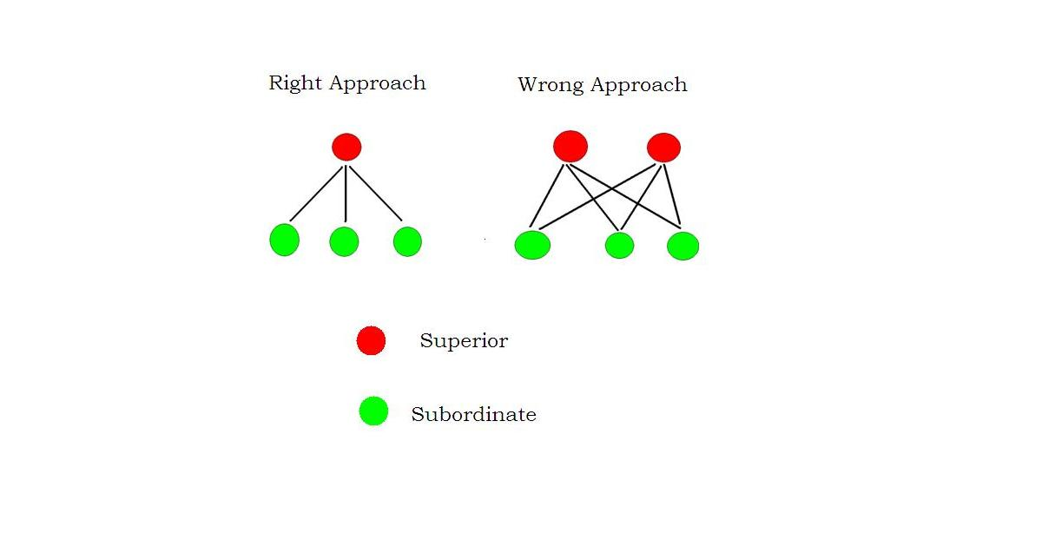
Unity of command
There should be a clear chain of command in place within an organization. An employee should know exactly whose instructions to follow.

Slide 9

Unity of direction
Work should be organized in a way that means employees are working in harmony toward a shared objective or goal using a shared method or procedure.

Slide 10

Subordination of individual interests to the collective interests
The interests of the organization as a whole should take precedence over the interests of any individual employee or group of employees. This encourages a team spirit and collective mentality of all for one and one for all.

Slide 11

Remuneration
In order to motivate and be fair to employees, they should be paid a reasonable rate for the work they carry out. An organization that underpays will struggle to attract quality workers who are motivated.

Slide 12
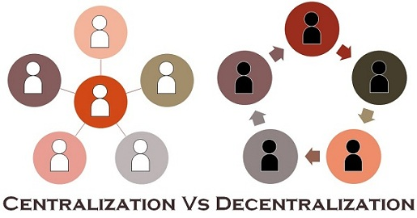
Centralization
This principle relates to whether decisions should be made centrally, as in from the top down, or in a more democratic way, from the bottom up. Different decision making processes are appropriate for different types of decisions.

Slide 13
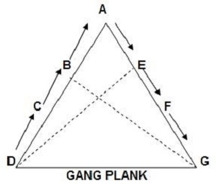
Scalar chain/Line of Authority
This relates to the principle of a clear chain of communication existing between employees and superiors. The chain should be respected, unless speedy communication is vital, in which case the chain may be bypassed if all parties consent.

Slide 14
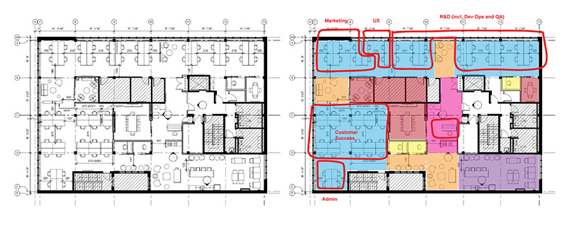
Order
Social order ensures the fluid operation of a company through authoritative procedure. Material order ensures safety and efficiency in the workplace. Order should be acceptable and under the rules of the company.

Slide 15

Equity
The management principle of equity often occurs in the core values of an organization. According to Henri Fayol, employees must be treated kindly and equally. Managers should supervise and monitor this process and they should treat employees fairly and impartially.

Slide 16

Stability of tenure of personnel
Finding that instability is both the cause and effect of bad management, Fayol points out the dangers and costs of unnecessary turnover. Management strives to minimize employee turnover and to have the right staff in the right place.

Slide 17

Initiative
Henri Fayol argued that with this management principle employees should be allowed to express new ideas. This encourages interest and involvement and creates added value for the company. Employee initiatives are a source of strength for the organization according to Henri Fayol. This encourages the employees to be involved and interested.

Slide 18

Esprit de Corps/Team Spirit
This principle implies that union is strength. Fayol here emphasizes on the need for teamwork and the importance of communication in obtaining it. Team spirit helps develop an atmosphere of mutual trust and understanding. Team spirit helps to finish the task on time.

